Slide 1
HARDCOPY
SHAHID SHAIK
MOHAN KRISHNAN
DHANASHREE
ZAKI

Slide 2
Problem Statement:
Many novels and books which were bought by students or employees are left unused after they done reading. Most number of books are left idle without any use for anyone.
What if we can generate most of its usage?
Buying number of books can’t be affordable to the regular & occasional readers.
What if we provide a medium to read their interested book on per day basis?
We’ll try to explain it in 5 W’s mode

Slide 3
5 W’s
Who- Who does the problem affect?
1.College students.
2.Employees (Gov, Private, software etc..)
3.Residents in townships, communities etc..
What- What would happen if we didn’t solve the problem?
Readers have to buy New books, E-books, old books from second hand book sellers etc…
The books which were bought have no use after they done reading them. It might be kept idle or given to someone.
What will happen when it is fixed?
Readers don’t have to buy books, they can just rent it from the Rentor’s in their location like colleges, Office Campuses, Townships etc… on per day basis.
Books can become assets to Rentors and can be monetized by using our medium.

Slide 4
When- When does this issue occur?
When user cannot able to afford to buy books/When user wants to limit their spending on books.
Having multiple books just sitting in their homes without any usage.
Where - Where is the issue occurring?
Occupying extra storage space for books in their Homes, PG’s, Flats which ofcourse generate no monetary value.

Slide 5
Why - Why is it important that we fix the problem?
Every one intends find way to read a book without spending high prices. By this resolution we are providing, readers can choose to read paper back with least expense instead of Digital books at low prices which in turn makes their reading a healthy activity.
Rentors can choose to help other interested readers indirectly by providing their book for renting on per day basis which he/she can monetize it by the way.
IMPACT ON ITS USERS:
All the users might be able to get the traction of the books available around his/her location, might be able to create their own interest in reading paperback copies & in renting books from or to others viceversa.
Notes:
E-books, Audio books etc..(Available at low prices since digitalization tried took over)

Slide 6
User Scenarios
Ankit Jain
30 years old from New Delhi,
Post Graduate in Computer Science
Works as Software Developer in MNC
Ananya Kaushik
Kumar
32 years old from Bangalore
A Homemaker.
25 years old from Mumbai
Pursuing MBA Technology Management
IPL Pune
He works as a Software Developer with
reputed MNC in New Delhi, Reading books is his usual habit. He wants to switch to a new technology but he wants to provide his books to the ones in need
He spoke to Ruthvik about this and he suggested him to make them available for renting in HARDCOPY app, where others might be helpful from these books .
Today he logs in to the app, ana monetize his rented books.
She lives with her husband and 2 kids in Singapore township in Bangalore. Her life is busy with doing everyday chores and has no time to find best comic books for her children.
Her neighbour recommended her to use the HARDCOPY App and insisted her to find and request available comic books in her locality, She also found some of her own interest recipe books
She finds the App very useful and easy to use.
Kumar is MBA Student from IPL, he usually read novels when in boredom. But good books are way too much price which he can't bare to purchase them
So, in search of a solution he got referral from one of his friends and found the HARDCOPY mobile app, where renting made easy and affordable. Now he can read as many books with minimal costs which he has to pay for the days he read them.
Finally he satisfied to be an user of HARDCOPY and increase the count of books in his shelf since then.

Slide 7
Solution
A feature packed mobile application which creates a platform for the users to keep their purchased books(novels, academic books etc..) in their inventory & make them available to other users who intends to read can rent it with a least expense.

Slide 8
Market statistics
Overall Book Market
1.India's book market is valued at 261 billion rupees ($4bn) according to a December 2015 survey by AC Nielsen in conjunction with the Association of Publishers in India and the Federation of Indian Publishers.
2.Reached $6.66bn in 2018 according to estimates by Nielsen’s report and expected to grow at CAGR of 19.3% by 2020
3.Despite technological advances, digital revenue is still only 3-4% of total sales.
4.Organised book retail constitutes of 7% of total 3000Cr retail Indian Book Industry and is expected to grow by 15% a year.
Second Hand Book Market
1.The books industry in India is growing at about 20%. Of the total industry, more than 10% makes for second hand books, estimates suggest.

Slide 9
Primary Research
1.Most of the books will bought from wholesalers and rest with public (90% and 10%)
2.In a quarter around 2700 books will sell by each seller, in this 15-20% for online
3.Price value vary from types of books purchased Novel vary from 40-50% academic vary from 30-60%
4.No second hand seller has been provided renting to their customers
5.Total revenue on annual basis for each seller was 8-10L
6.Each seller is interlinked with 40-50 stores around him
7.Most unused books are sold per/kg basis

Slide 11
Money Track
Customers 2
Low price
Unused books per/kg basis
Bulk inventory
2nd hand book
sellers
Buying
wholesalers
Customers
Low price
selling
Books & discounted price
Commission
Online retailers

Slide 12
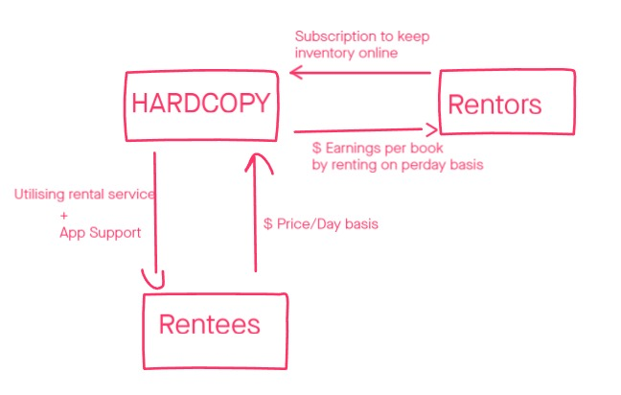

Slide 13
a. What is the problem and how are you solving for it?
b. Why do you believe this is a big issue and what are insights that support your reasoning?
c. Describe your product, your customer and market segments.
d. Who are your competitors? How are you different?
e. How do you create impact and how are you measuring it? What are your impact numbers for the last year? Who are your beneficiaries?
f. What are your sales, revenues & gross margins? What are your sales & financial projections?
g. Briefly describe your founding team. Financial Projections & Key Metrics (max 400 words)
h. How much funding are you looking for? How do you plan to utilize it?

